Slide 1
NOMENCLATURE AND CLASSIFICATION SYSTEMS OF VIRUSES
ICTV NOMENCLATURE AND CLASSIFICATION OF VIRUSES (Based on 9th Report-version 2012)

Slide 2
Classifying subcellular infectious agents is more complex than it may appear at first sight, and it is appropriate to start with a few definitions: - Systematics is the science of organizing the history of the evolutionary relationships of organisms. -Classification is determining the evolutionary relationships between organisms. - Identification is recognizing the place of an organism in an existing classification scheme, often using dichotomous keys to identify the organism. -Taxonomy (nomenclature) is assigning scientific names according to agreed international scientific rules.

Slide 3
The official taxonomic groups (from the largest to the smallest are): -Kingdom (e.g., animals, plants, bacteria; does not apply to viruses) - Phylum (e.g., vertebrates; does not apply to viruses) - Class (group of related orders; does not apply to viruses) - Order (group of related families) - Family (group of related genera) - Genus (group of related species) - Species, the smallest taxonomic group

Slide 4
Subcellular agents present a particular problem for taxonomists. They are too small to be seen without electron microscopes, but very small changes in molecular structure may give rise to agents with radically different properties. The vast majority of viruses that are known have been studied because they have pathogenic potential for humans, animals, or plants; therefore, the disease symptoms caused by infection are one criterion used to aid classification. The physical structure of a virus particle can be determined directly (by electron microscopy) or indirectly (by biochemical or serological investigation) and is also used in classification. However, the structure and sequence of the virus genome continue to increase in importance as molecular biological analysis provides a rapid and sensitive way to detect and differentiate many diverse viruses.

Slide 5
In 1966, the International Committee on Nomenclature of Viruses was established and produced the first unified scheme for virus classification. In 1973, this committee expanded its objectives and renamed itself the International Committee on Taxonomy of Viruses (ICTV), which meets every four years.

Slide 6
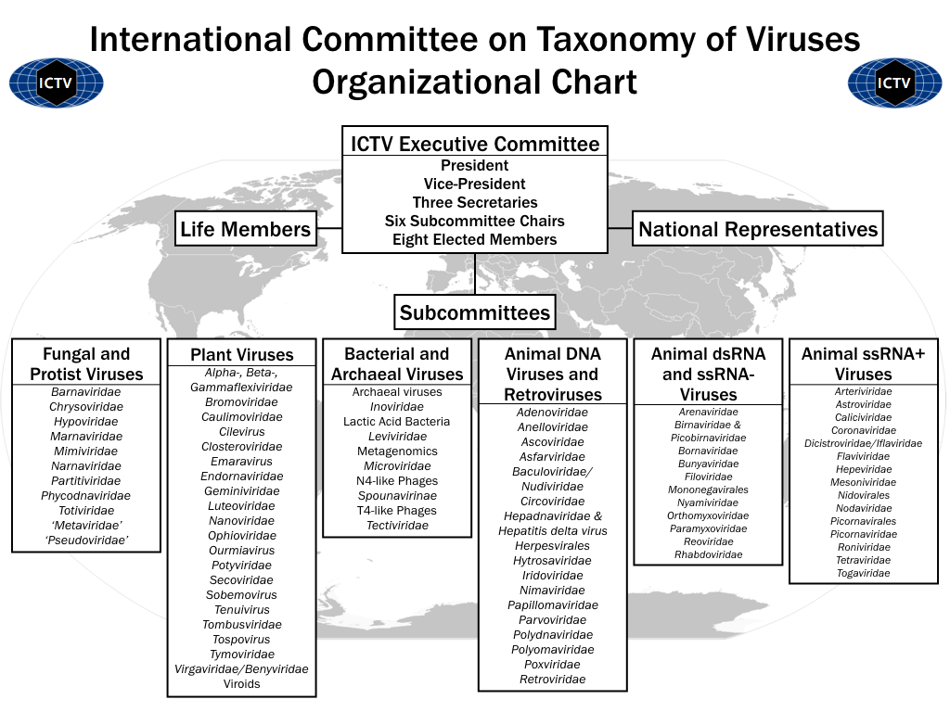

Slide 7
ICTV's Principles of nomenclature : The ICTV's essential principles of virus nomenclature are: - To aim for stability; - To avoid or reject the use of names which might cause error or confusion; - To avoid the unnecessary creation of names ( Nomenclature of viruses is independent of other biological nomenclature. Virus taxon nomenclature is recognized as an exception in the proposed International Code of Bionomenclature (BioCode). The primary purpose of naming a taxon is to supply a means of referring to the taxon, rather than to indicate the characters or history of the taxon. The name of a taxon has no official status until it has been approved by ICTV.)

Slide 8
Rules for virus taxonomy have been established, some of which include: -Latin binomial names (e.g., Rhabdovirus carpio) are not used. No person’s name should be used in nomenclature. Names should have international meaning. - A virus name should be meaningful and should consist of as few words as possible. Serial numbers or letters are not acceptable as names. - A virus species is a polythetic class (i.e., a group whose members always have several properties in common, although no single common attribute is present in all of its members) of viruses that constitute a replicating lineage and occupy a particular ecological niche.

Slide 9
- A genus is a group of virus species sharing common characters. Approval of a new genus is linked to the acceptance of a type species (i.e., a species that displays the typical characteristics on which the genus is based). - A family is a group of genera with common characters.Approval of a new family is linked to the acceptance of a type genus. In general terms, groups of related viruses are divided into families whose names end in the suffix ‘viridae’ (e.g., Poxviridae). In most cases, a higher level of classification than the family has not been established, although three orders (groups of related families) have now been recognized. In a few cases, very large families have been subdivided into subfamilies and end in the suffix ‘virinae.’ Subspecies, strains, isolates, variants, mutants, and artificially created laboratory recombinants are not officially recognized by the ICTV.

Slide 10
- The names of virus orders, families, subfamilies, genera and species should be written in italics with the first letter capitalized. - Other words are not capitalized unless they are proper nouns (e.g., Tobacco mosaic virus, Poliovirus, Murray River encephalitis virus). - This format should only be used when official taxonomic entities are referred to—it is not possible to centrifuge the species Poliovirus, for example, but it is possible to centrifuge poliovirus. - Italics and capitalization are not used for vernacular usage (e.g., rhinoviruses; cf. the genus Rhinovirus), for acronyms (e.g., HIV-1), nor for adjectival forms (e.g., poliovirus polymerase).

Slide 11
#According to 9th report of ICTV: Decimal code: 1.The ICTV classification uses an eight position decimal code to represent order, family, subfamily, genus, species, subspecies, serotype or subtype, and strain or isolate. 2. Each position in the code uses 1, 2, or 3 numerical digits. The decimal code identifies a virus to the level of strain or isolate. Two examples are shown in the table below.

Slide 12
